Slide 1

CMP302: Algorithms
Lecture 03: Recurrences
and
Divide and Conquer
Mayada Mansour Hadhoud
Computer Engineering Department
Cairo University
Fall 2014

Slide 2
Recurrences
Backward substitution
Recursion tree
Master theorem

Slide 3
Recursion Tree Method
A recursion tree models the costs (time) of a recursive execution of an algorithm.
The recursion tree method is good for generating guesses for the substitution method.

Slide 4

Recursion Tree Example

Slide 5

Recursion Tree Example

Slide 6
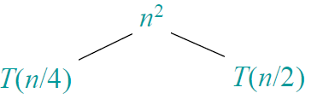
Recursion Tree Example

Slide 7
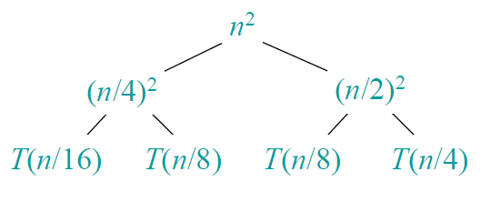
Recursion Tree Example

Slide 8
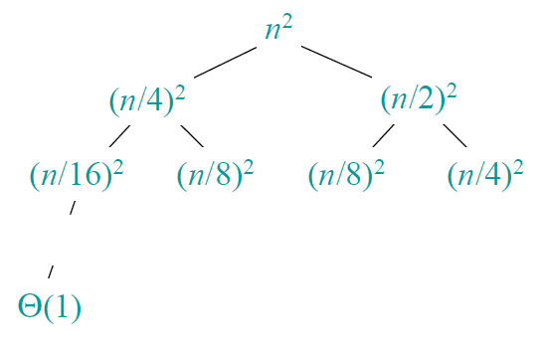
Recursion Tree Example

Slide 9
Recursion Tree Example

Slide 10

Recursion Tree Example

Slide 11

Recursion Tree Example

Slide 12
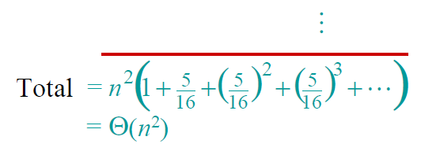
Recursion Tree Example

Slide 13
The Master Theorem
Applies to recurrences of the form :
T(n) = aT(n/b) + f (n) where f(n) ∈ Θ(n^{d}), d ≥ 0
Master Theorem: If a < b^{d}, T(n) ∈ Θ(n^{d}) (Case 1)
If a = b^{d}, T(n) ∈ Θ(n^{d} log n) (Case 2)
If a > b^{d}, T(n) ∈ Θ(n^{log b a} ) (Case 3)
Note: The same results hold with O instead of Θ.

Slide 14
Group Activity
Compute the Complexity of the following functions in terms of
T(n) = 4T(n/2) + n ⇒ T(n) ∈ ?
T(n) = 4T(n/2) + n² ⇒ T(n) ∈ ?
T(n) = 4T(n/2) + n³ ⇒ T(n) ∈ ?
T(n) = 2T(n/2) + 1 ⇒ T(n) ∈ ?
Θ
Θ(n^2) Case 3
Θ(n^2log n) Case 2
Θ(n^3) Case 1
Θ(n) Case 3

Slide 15
Divide and Conquer Design Strategy
Divide the problem instance into subproblems.
Conquer the subproblems by solving them recursively.
Combine subproblems solutions

Slide 16
Divide and Conquer Design Strategy
a problem of size n
(instance)
subproblem 1
of size n/2
subproblem 2
of size n/2
a solution to
subproblem 1
a solution to
subproblem 2
It general leads to a recursive algorithm!
a solution to
the original problem

Slide 17
General Divide-and-Conquer Recurrence
General case analysis
Given a problem of size n
Assume that can be divided into b instances of size (n/b)
a problems of (n/b) are the one that solved
The time needed for the dividing the problem and summing the solutions back is f(n)
Time complexity of Divide and Conquer
T(n) = aT(n/b) + f (n)

Slide 18
Merge sort
Split array A[0..n-1] into about equal halves and make copies of each half in arrays B and C
Sort arrays B and C recursively
Merge sorted arrays B and C into array A as follows:
Repeat the following until no elements remain in one of the arrays:
compare the first elements in the remaining unprocessed portions of the arrays
copy the smaller of the two into A, while incrementing the index indicating the unprocessed portion of that array
Once all elements in one of the arrays are processed, copy the remaining unprocessed elements from the other array into A.

Slide 19
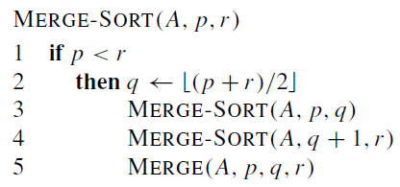
Pseudo code of Merge sort
Divide the array into 2 subarrays
Conquer: recursively sort the 2 subarrays
Combine :merge the 2 sorted arrays

Slide 20
Mergesort Example
Notes:
Go over this example in detail, then do another example of merging, something like:
(1 2 5 7 9)
(3 4 6)

Slide 21
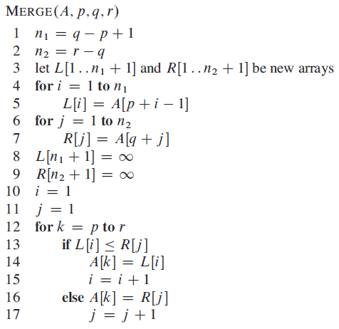
The Pseudocode of Merge part
Time complexity: Θ(p+q) = Θ(n) comparisons

Slide 22
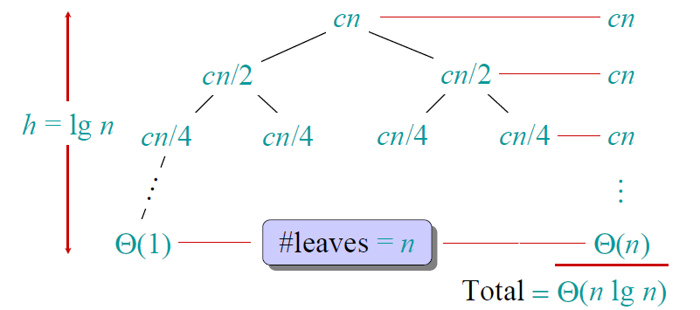
Analysis of Mergesort
Using recursion tree
Notes:
even if not analyzing in detail, show the recurrence for mergesort in worst case:
T(n) = 2 T(n/2) + (n-1)
worst case comparisons for merge

Slide 23
Analysis of Mergesort
Using Master theorem
At every step , I divide the elements by 2 Then b =2
Also the number of problems to be solved with each subproblem every time is a= 2
f(n) ????
F(n) requires in the worst case almost (n-1) comparisons based * the number of recurrences.
T(n) = 2T(n/2) + n-1 =???
Space requirement: Merge Sort does not sort “in place” as it needs temporary space for the “Merge” subroutine Θ(n)
T(n) = 2T(n/2) + f(n), T(1) = 0
If a = b^{d}, T(n) ∈ Θ(n^{d} log n) =
Θ(n log n)
Notes:
even if not analyzing in detail, show the recurrence for mergesort in worst case:
T(n) = 2 T(n/2) + (n-1)
worst case comparisons for merge

Slide 24
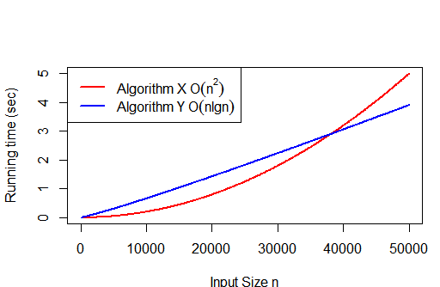
Insertion sort Vs. Merge sort
Insertion Sort:
T(n) = Θ(n²)
S(n) = Θ(1)
Merge Sort:
T(n) = Θ(n log n)
S(n) = Θ(n)
Insertion sort better for smaller n, merge sort for larger n

Slide 25
Example1: Binary Search
Find an element in a sorted array
Divide :check the middle element
Conquer: recursively search 1 subarray
Combine : return the index

Slide 26
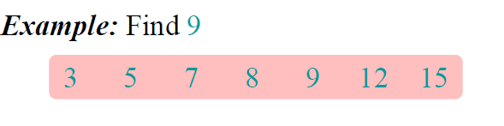




Example1: Binary Search

Slide 27
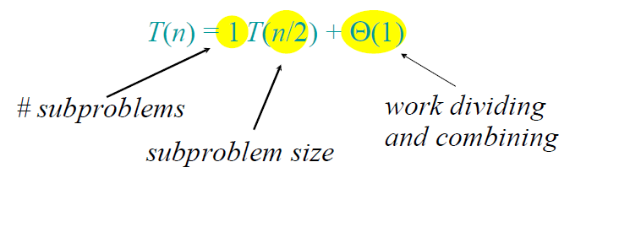
Binary Search Recurrence
a=1, b=2 and d=0
If a = b^{d}, T(n) ∈ Θ(n^{d} log n) (Case 2)
T(n)= Θ(logn)

Slide 28
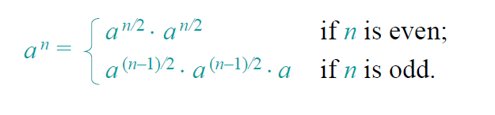

Example2: Powering a number
Problem : Compute a^{n}
Brute force : Θ(n)
Divide and Conquer :

Slide 29
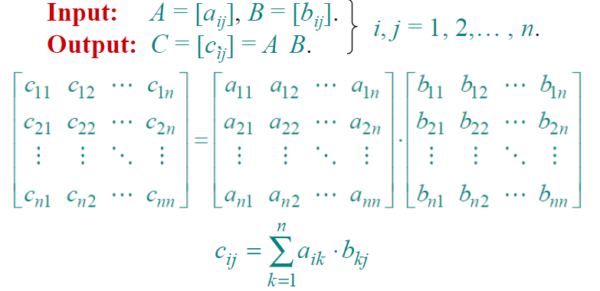
Example3: Matrix Multiplication

Slide 30
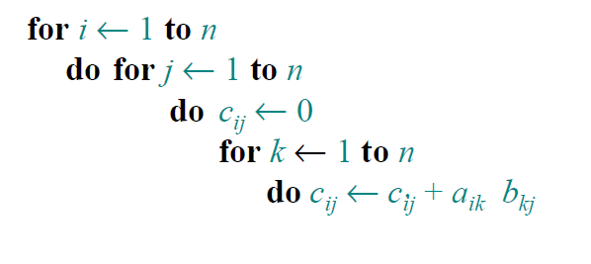

Example3: Matrix Multiplication
Brute force:
Notes:
How we calculate it
First input size =n
Basic operation is multiplication
Number of multiplications = O(n^3)

Slide 31
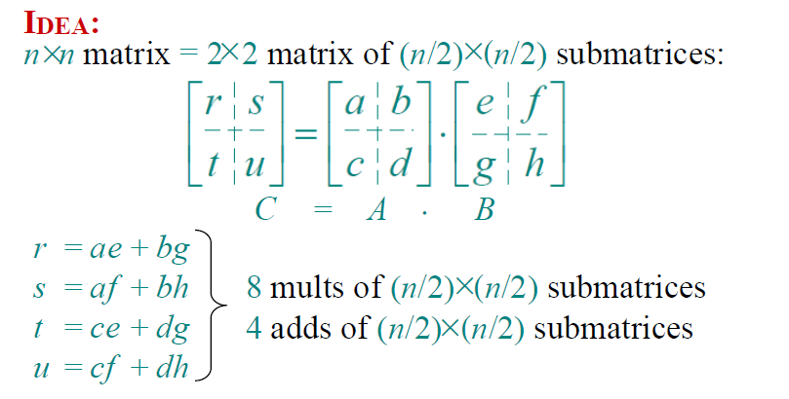
Example3: Matrix Multiplication
Divide and Conquer
Notes:
How we calculate it
First input size =n
Basic operation is multiplication
Number of multiplications = O(n^3)

Slide 32
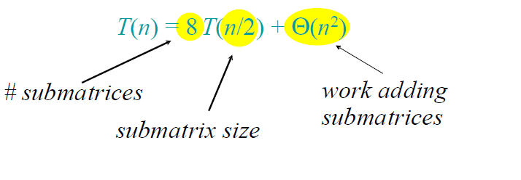
Example3: Matrix Multiplication
Divide and Conquer
a=8, b=2 and d=2
If a > bd, T(n) ∈ Θ(nlog b a ) (Case 3)
T(n)= Θ(n³)
Notes:
How we calculate it
First input size =n
Basic operation is multiplication
Number of multiplications = O(n^3)

Slide 33
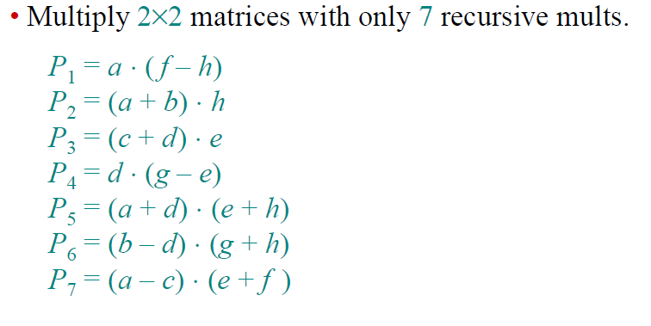
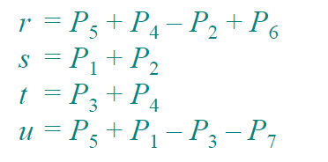
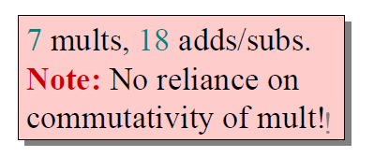
Example3: Matrix Multiplication
Strassen’s idea
Notes:
How we calculate it
First input size =n
Basic operation is multiplication
Number of multiplications = O(n^3)

Slide 34
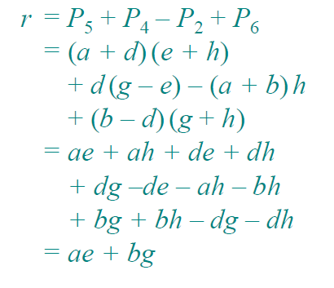
Example3: Matrix Multiplication
Strassen’s idea
Notes:
How we calculate it
First input size =n
Basic operation is multiplication
Number of multiplications = O(n^3)

Slide 35
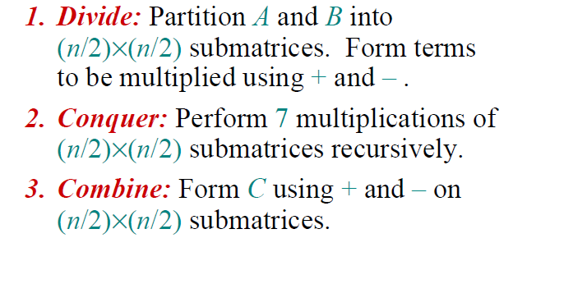

Example3: Matrix Multiplication
Strassen’s idea
Notes:
How we calculate it
First input size =n
Basic operation is multiplication
Number of multiplications = O(n^3)

Slide 36
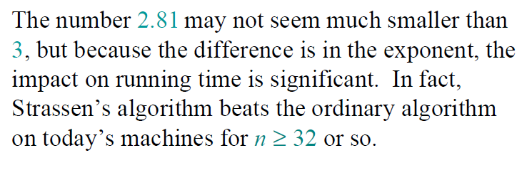
Example3: Matrix Multiplication
Strassen’s idea
a=7, b=2 and d=2
If a > bd, T(n) ∈ Θ(nlog b a ) (Case 3)
T(n)= Θ(n^{2.81})
Notes:
How we calculate it
First input size =n
Basic operation is multiplication
Number of multiplications = O(n^3)

Slide 37
Quicksort
Select a pivot (partitioning element) – here, the first element
Rearrange the list so that all the elements in the first s positions are smaller than or equal to the pivot and all the elements in the remaining n-s positions are larger than or equal to the pivot Exchange the pivot with the last element in the first (i.e., ≤) subarray — the pivot is now in its final position
Sort the two subarrays recursively
S
v
v
S1
S2

Slide 38
Dividing Process
For each partition , you select the pivot index , and first and last elements indexes (s, i, j)
i moves from left-to-right (looks for elements smaller than the pivot)
j moves from right-to-left (looks for elements greater than the pivot)
When both stops , we got three cases :
i< j ➔ Swap (A[i], A[j])
i> j ➔ array is partitioned Swap( pivot A[s], A[j])
i=j ➔ A[i]=A[j]=A[s]

Slide 39
Example
We are given array of n integers to sort:
40
20
10
80
60
50
7
30
100

Slide 40
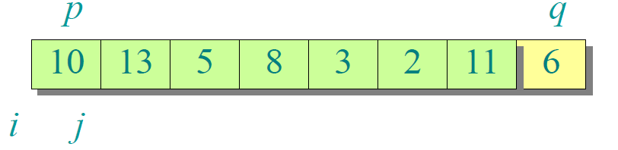
Pick Pivot Element
There are a number of ways to pick the pivot element. In this example, we will use the last element in the array:

Slide 41
Partitioning Array
Given a pivot, partition the elements of the array such that the resulting array consists of:
One sub-array that contains elements >= pivot
Another sub-array that contains elements < pivot
The sub-arrays are stored in the original data array.
Partitioning loops through, swapping elements below/above pivot.

Slide 43
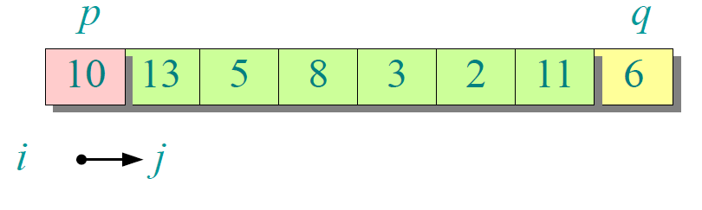

Slide 44
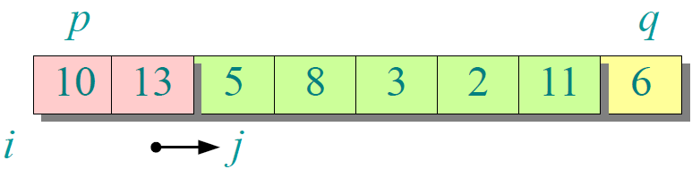

Slide 45
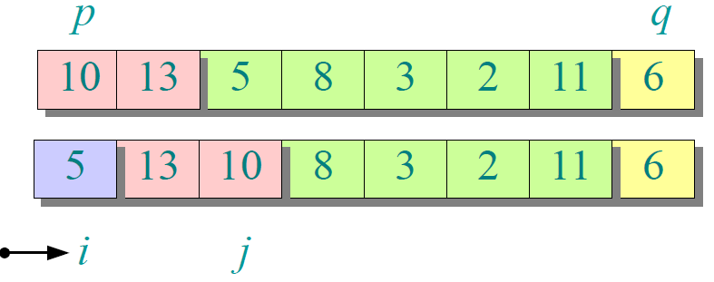

Slide 46
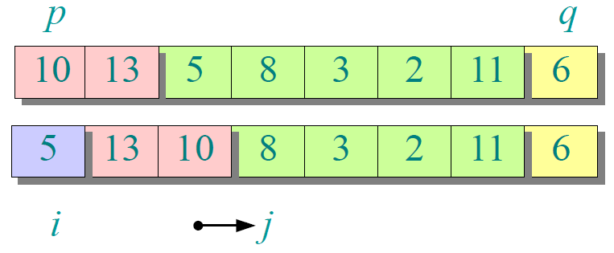

Slide 47
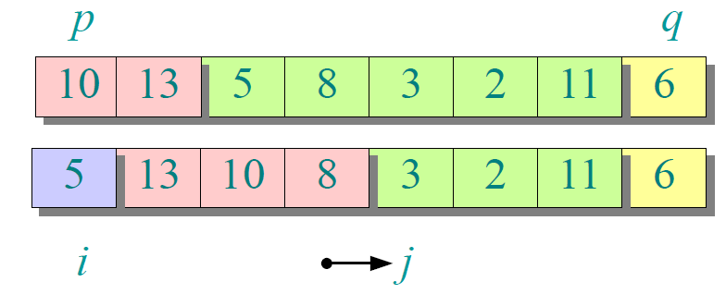

Slide 48
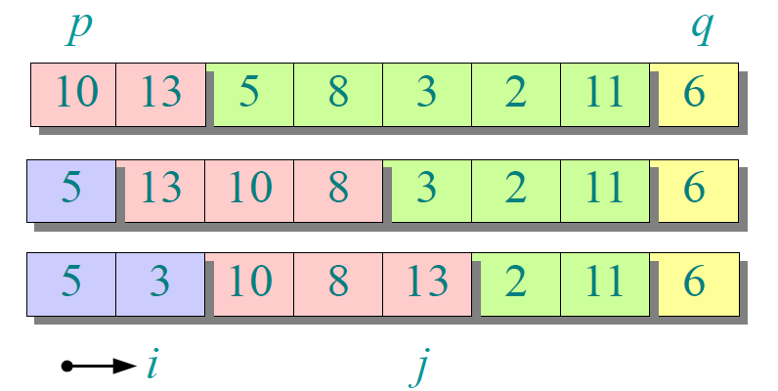

Slide 49
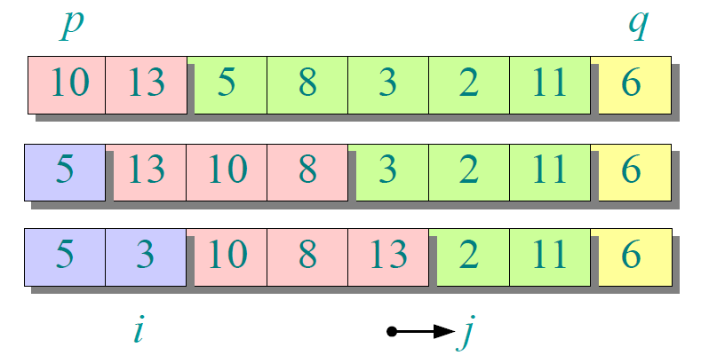

Slide 50
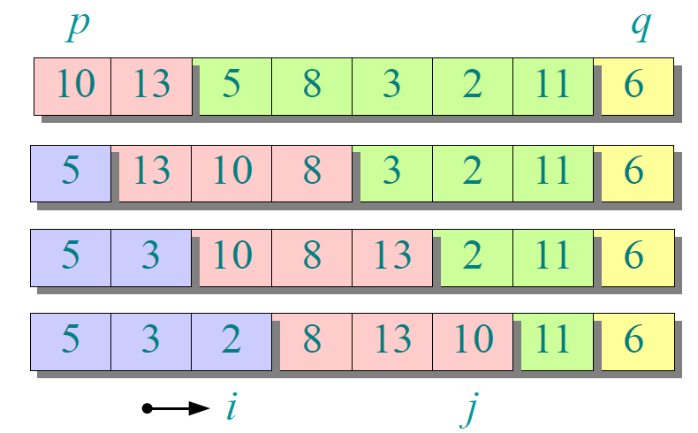

Slide 51
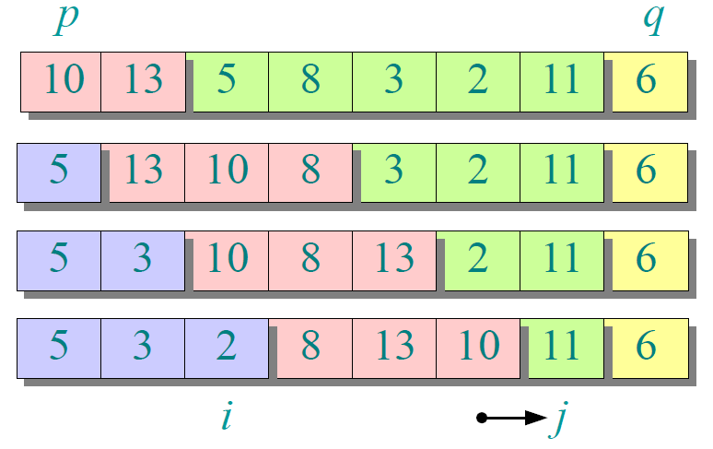

Slide 52
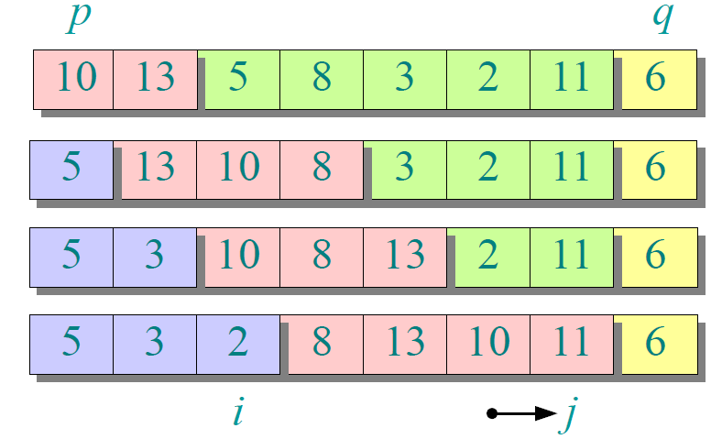

Slide 53
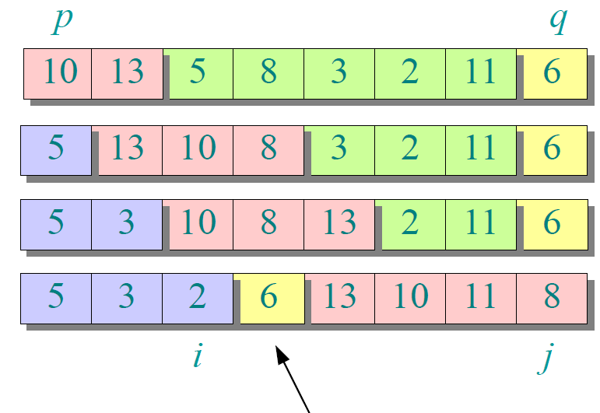

Slide 54
Partition Result
5
3
2
6
13
10
11
8
[0] [1] [2] [3] [4] [5] [6] [7]
<= data[pivot]
> data[pivot]

Slide 55
Recursion: Quicksort Sub-arrays
5
3
2
6
13
10
11
8
[0] [1] [2] [3] [4] [5] [6] [7]
<= data[pivot]
> data[pivot]

Slide 56
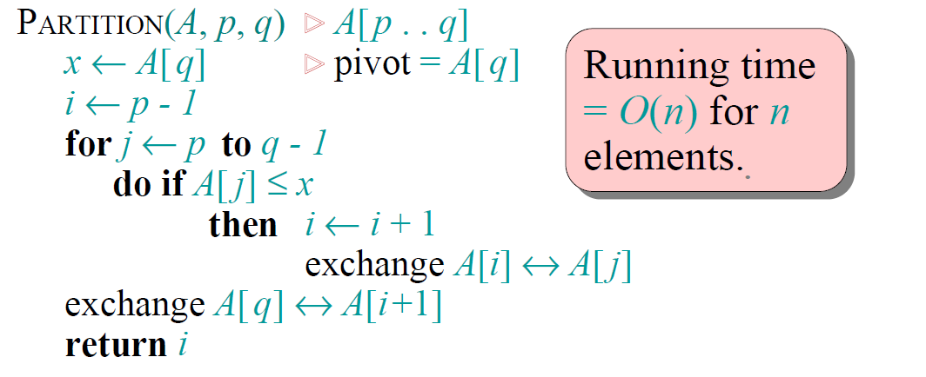
Partitioning Algorithm
or i > r
or j = l
<

Slide 57
Quicksort Analysis
Assume that keys are random, uniformly distributed.
What is best case running time?

Slide 58
Quicksort Analysis
Assume that keys are random, uniformly distributed.
What is best case running time?
Recursion:
Partition splits array in two sub-arrays of size n/2
Quicksort each sub-array

Slide 59
Quicksort Analysis
Assume that keys are random, uniformly distributed.
What is best case running time?
Recursion:
Partition splits array in two sub-arrays of size n/2
Quicksort each sub-array
Depth of recursion tree?

Slide 60
Quicksort Analysis
Assume that keys are random, uniformly distributed.
What is best case running time?
Recursion:
Partition splits array in two sub-arrays of size n/2
Quicksort each sub-array
Depth of recursion tree? O(log₂n)

Slide 61
Quicksort Analysis
Assume that keys are random, uniformly distributed.
What is best case running time?
Recursion:
Partition splits array in two sub-arrays of size n/2
Quicksort each sub-array
Depth of recursion tree? O(log₂n)
Number of accesses in partition?

Slide 62
Quicksort Analysis
Assume that keys are random, uniformly distributed.
What is best case running time?
Recursion:
Partition splits array in two sub-arrays of size n/2
Quicksort each sub-array
Depth of recursion tree? O(log₂n)
Number of accesses in partition? O(n)

Slide 63
Quicksort Analysis
Assume that keys are random, uniformly distributed.
Best case running time: O(n log₂n)

Slide 64
Quicksort Analysis
Assume that keys are random, uniformly distributed.
Best case running time: O(n log₂n)
Worst case running time?

Slide 65
Quicksort: Worst Case
Assume first element is chosen as pivot.
Assume we get array that is already in order:
pivot_index = 0
2
4
10
12
13
50
57
63
100
[0] [1] [2] [3] [4] [5] [6] [7] [8]

Slide 66
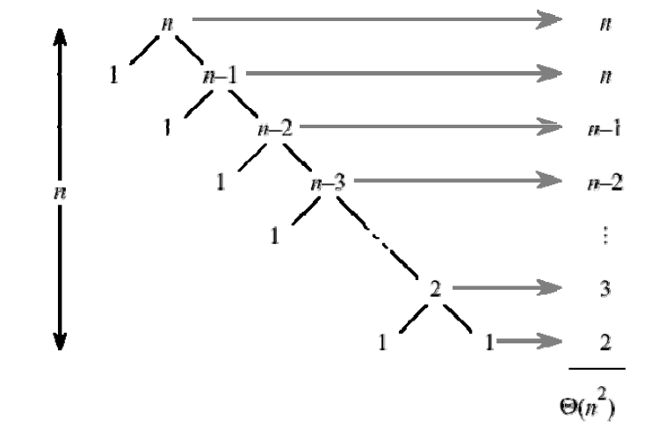
Quick Sort

Slide 67
Quicksort Analysis
Assume that keys are random, uniformly distributed.
Best case running time: O(n log₂n)
Worst case running time?
Recursion:
Partition splits array in two sub-arrays:
one sub-array of size 0
the other sub-array of size n-1
Quicksort each sub-array
Depth of recursion tree?

Slide 68
Quicksort Analysis
Assume that keys are random, uniformly distributed.
Best case running time: O(n log₂n)
Worst case running time?
Recursion:
Partition splits array in two sub-arrays:
one sub-array of size 0
the other sub-array of size n-1
Quicksort each sub-array
Depth of recursion tree? O(n)

Slide 69
Quicksort Analysis
Assume that keys are random, uniformly distributed.
Best case running time: O(n log₂n)
Worst case running time?
Recursion:
Partition splits array in two sub-arrays:
one sub-array of size 0
the other sub-array of size n-1
Quicksort each sub-array
Depth of recursion tree? O(n)
Number of accesses per partition?

Slide 70
Quicksort Analysis
Assume that keys are random, uniformly distributed.
Best case running time: O(n log₂n)
Worst case running time?
Recursion:
Partition splits array in two sub-arrays:
one sub-array of size 0
the other sub-array of size n-1
Quicksort each sub-array
Depth of recursion tree? O(n)
Number of accesses per partition? O(n)

Slide 71
Quicksort Analysis
Assume that keys are random, uniformly distributed.
Best case running time: O(n log₂n)
Worst case running time: O(n²)!!!

Slide 72
Quicksort Analysis
Assume that keys are random, uniformly distributed.
Best case running time: O(n log₂n)
Worst case running time: O(n²)!!!
What can we do to avoid worst case?

Slide 73
Analysis of Quicksort
Best case: split in the middle — Θ(n log n)
Worst case: sorted array! — Θ(n²)
Average case: random arrays — Θ(n log n)
Improvements:
better pivot selection: median of three partitioning
switch to insertion sort on small subfiles
elimination of recursion
These combine to 20-25% improvement
T(n) = T(n-1) + Θ(n)

